Slide 1




Diagnosability under Weak Fairness
Vasileios Germanos¹, Stefan Haar²,
Victor Khomenko¹, and Stefan Schwoon²
¹School of Computing Science, Newcastle University, UK
²INRIA & LSV (ENS Cachan & CNRS), France

Slide 2
Diagnosis
observations
system
diagnosis
faults
actions
detection, localisation
and identification
of faults

Slide 3
Diagnosability
Diagnosability: the possibility of detecting faults by monitoring the visible behaviour of the system, i.e. a system is diagnosable if an occurrence of a fault can be eventually detected by the observer
A verifiable property of a system

Slide 4
Witness of diagnosability violation
aaXcdacYddeaaZcc…
no fault
Infinite executions
XYZ…
ccaXdYfadeaaaZee…

Slide 5
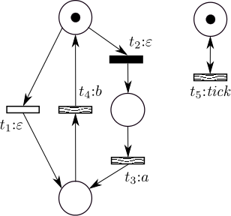
System model & example
  Labelled Petri net: ℓ : T → O ∪ {ε}
  Set of faults F ⊆ T
  Assumptions:
    ℓ(F)={ε}
    no deadlocks/divergence
Notes:
White – unobservable
Black – fault
Shaded – observable
Divergence: infinite execution of hidden transitions

Slide 6
Witness of undiagnosability
t₂
t₅
t₅
t₅
t₅
t₅
t₅
t₂t₅^{ω} contains a fault, but cannot be distinguished from t₅^{ω} because t₃ can be perpetually ignored
Becomes diagnosable if t₅ is removed
Pathology: unrelated concurrent activity makes a PN undiagnosable!

Slide 7
Weak Fairness (WF)
Some transitions can be declared WF
A WF transition cannot stay perpetually enabled, it must eventually either fire or become disabled by another transition (c.f. W. Vogler)
Hence some infinite executions (those that perpetually enable some WF transition) are considered invalid and removed from the semantics of PN

Slide 8
Fixing diagnosability with WF
WF
The diagnosability violation witness (t₂t₅^{ω}, t₅^{ω}) is now invalid because t₂t₅^{ω} perpetually enables t₃

Slide 9
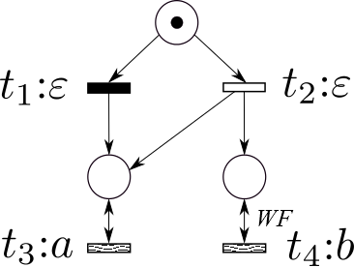
Naïve definition of WF diagnosability
Idea: Require that the executions forming a witness of diagnosability violation are WF
Doesn’t work ☹
The infinite trace a^{ω} must be observed for positively concluding that the fault
has occurred!

Slide 10
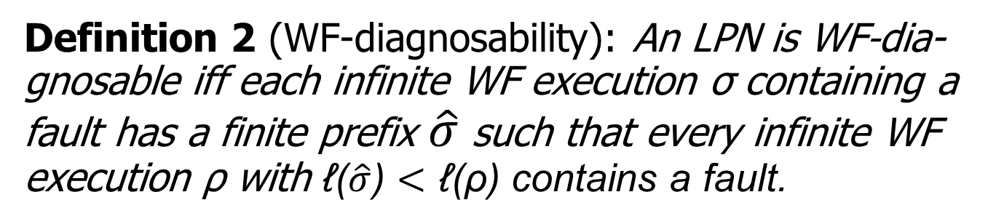

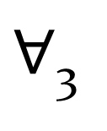
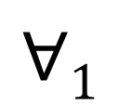
Weakly fair diagnosability
Definition 2 (WF-diagnosability): An LPN is WF-dia-gnosable iff each infinite WF execution σ containing a
fault has a finite prefix $\hat{σ}$ such that every infinite WF
execution ρ with ℓ($\hat{σ}$) $<$ ℓ(ρ) contains a fault.
$$∃_{2}\hat{σ}$$
σ
$$∀1$$
∞^{WF}
ρ
$∀$₃
∞^{WF}

Slide 11

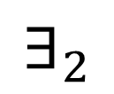
Witness of WF-undiagnosability
No natural notion in general case
For the case of a bounded PN:
σ
∞^{WF}
ρ
not necessarily WF!
∞
no fault
∞^{WF}
no fault
$$∀_{1}\hat{ρ}$$
$$∃_{2}$$
Notes:
A pair of infinite executions is called witness when a WF infinite execution σ contains a fault and every finite prefix, of infinite execution which not necessarily WF,
Can continue as a WF infinite execution without fault.

Slide 12
Witness of WF-undiagnosability

Slide 13
Special case for WF-diagnosability
Can simplify the notion of witness for non-WF faults:
σ
∞^{WF}
ρ
not necessarily WF!
no fault
∞

Slide 14
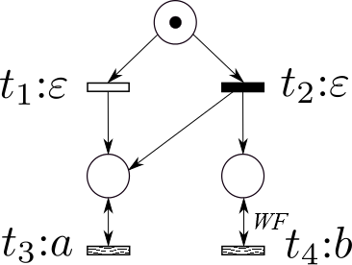
Verification of WF-diagnosability
Assume bounded LPN with non-WF faults
Construct another bounded LPN called verifier, which
consists of the fault tracking net.
Check a fixed LTL-X property on WF executions of verifier

Slide 15
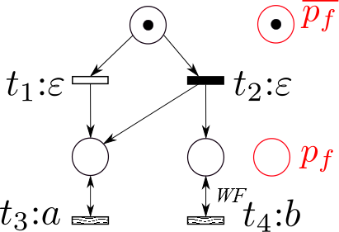
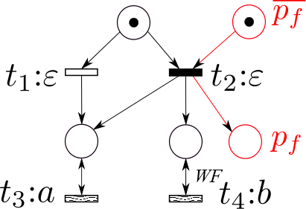
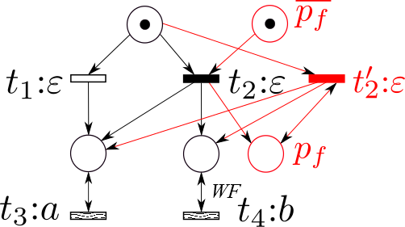
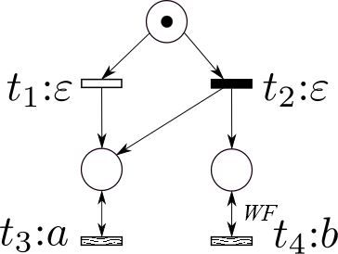
Fault tracking net N^{ft}

Slide 16
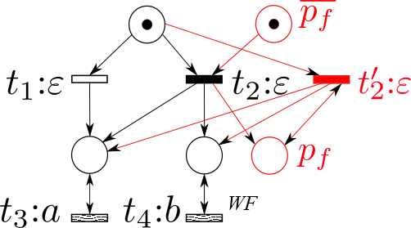
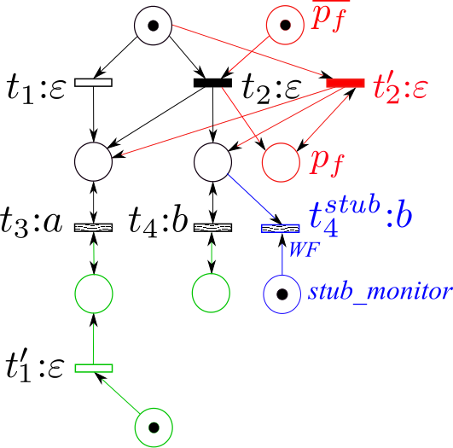
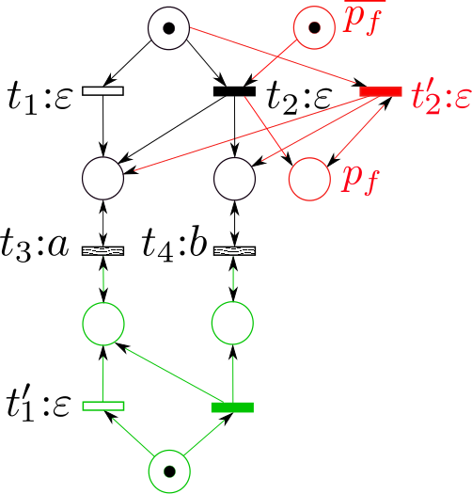
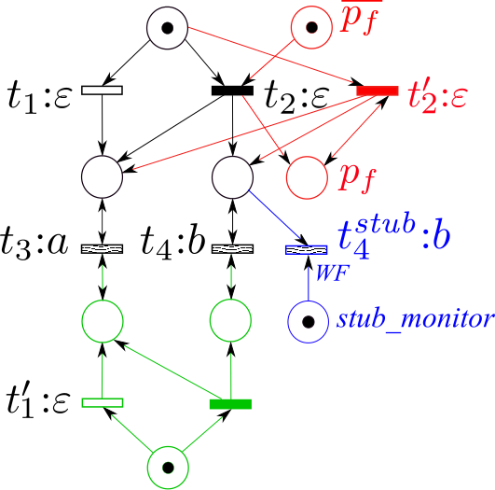
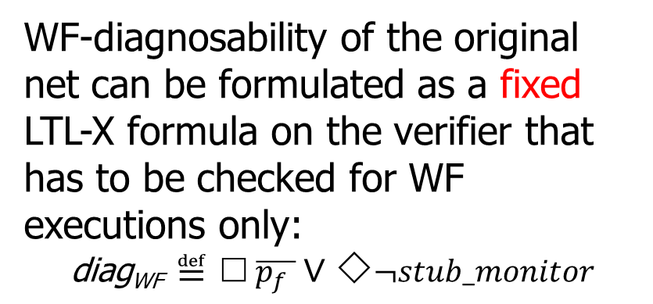
Verifier
WF-diagnosability of the original net can be formulated as a fixed LTL-X formula on the verifier that has to be checked for WF executions only:
$$\text{diag}\text{WF} ≝≤ \overline{p_{f} }∨↓¬stub_monitor$$

Slide 17
Advantages of the method
Any PN model checker supporting WF and LTL-X can be used
Can exploit the modular structure of the verifier (it is a synchronous product of two nets)
Can easily be extended to high-level PNs

Slide 18
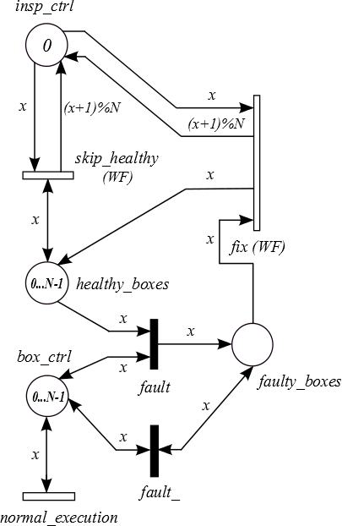
COMMBOX benchmark (high-level PN)
Inspector
Commutator
boxes
Notes:
The inspector run around the commutator boxes and checks/fixes possible faults

Slide 19
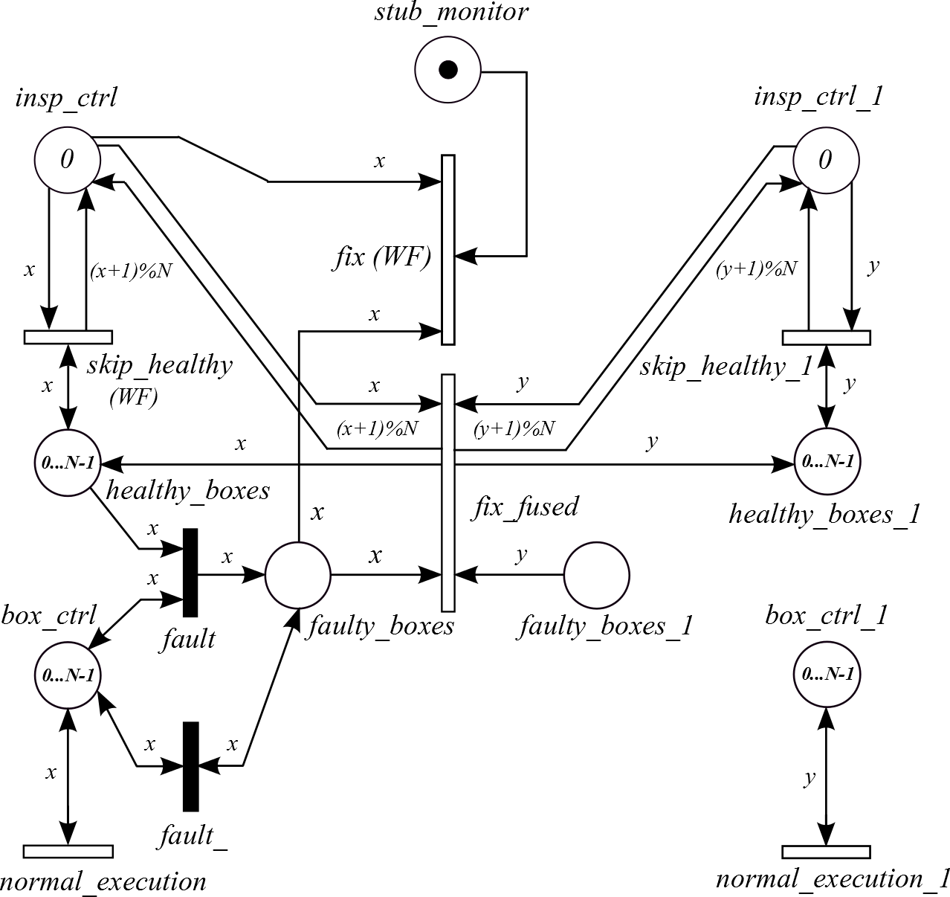
COMMBOX verifier (high-level PN)

Slide 20
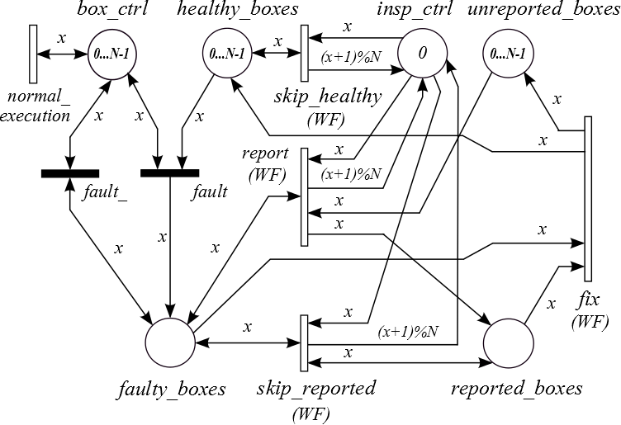
COMMBOXTECH benchmark (high-level PN)
Commutator
boxes
Inspector
Technician

Slide 21
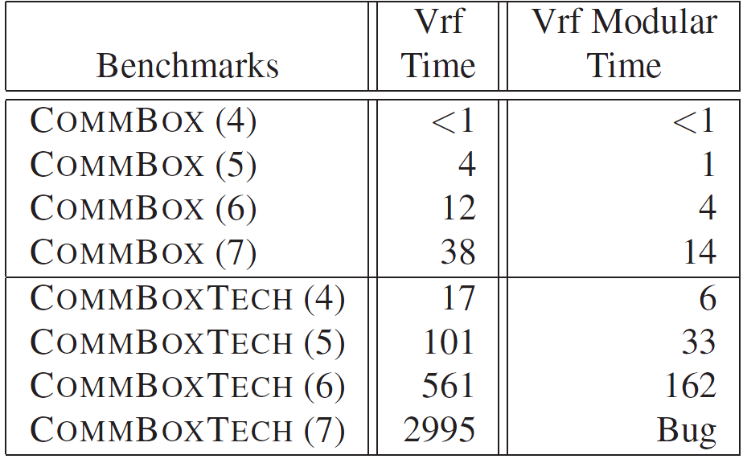
Experimental results (MARIA tool)

Slide 22
Experimental results: summary
No benchmarks – had to create our own
No tools to compare with
Verification is feasible and efficient
Also verified that WF is essential here – dropping WF constraints results in loss of diagnosability
  except for skip_reported in CommBoxTech

Slide 23
Conclusions
WF helps – more systems become diagnosable!
Corrected the notion of WF-diagnosability
Notion of a witness for the bounded PN, which can be simplified for the non-WF faults
Method for verifying WF-diagnosability by reduction to LTL-X
Scalable benchmarks and experimental evaluation

Slide 24
Thank you!
Any questions?

